Slide 1
5 Things Time does to your Data.
Using Data Governance to
Avoid Truth Decay

Slide 2
The Data
What is time?
Time is a dimension.
We know the past exists (we have shared memories and records)
We assume based on past experiences that there is a future
We know based on observation that for some their future “ceased”
Everything is subject to the effects of time.
1. Data Decay (Data rots and contaminates good data)
2. Latency (Data can arrive too late causing issues)
3. Data in the minds of people (blocking new ways of Data Management)
4. Data Management Maturity (evolving with ageing data & systems)
5. Truth and Changing Meta-data

Slide 3

Data Decay
All Data has a decay rate, each data asset decays due to forces beyond our view.
Assess the forces changing the truth of your data as it relates to the real world around you (but do not change history, rather process a contra entry.)
Test and quality-spot-check to find decayed data quickly, because decayed data corrupts good data – you lose trust, even in the good data around it
Takeaways from the Analogy of A Supermarket.
(Data Decay is a constant threat)
  All the items are different data assets
  All the people are data stewards of the data
  The customers are the users
https://www.youtube.com/watch?v=Bx0okLlcaC4

Slide 4
Key Take-Aways (Business-Guys)
Show every person in your company that they change the real world when they change the virtual world
Get Data Stewards to work with data, identify it, catalogue it, organize it and set “Use-by” and “Sell-by” Dates for your Internal and external customers
Create a culture of hygiene and effective management of quality, taking decaying data out of circulation

Slide 5
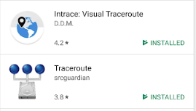
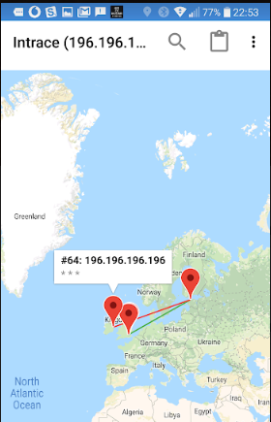
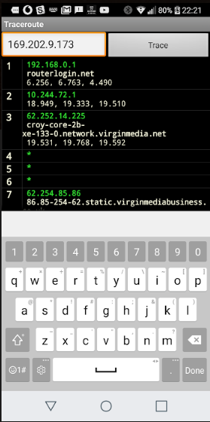
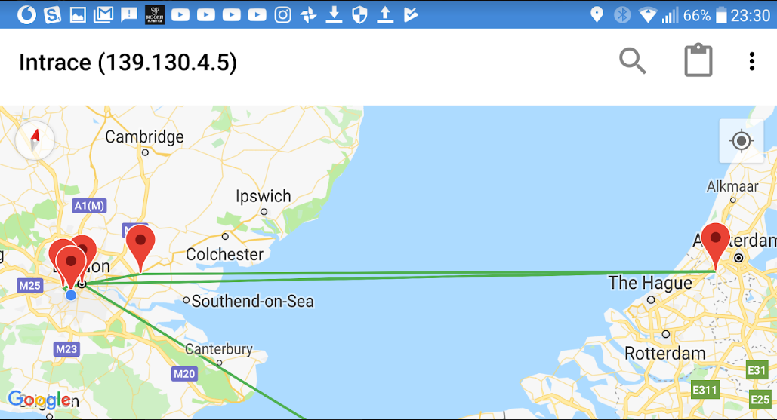
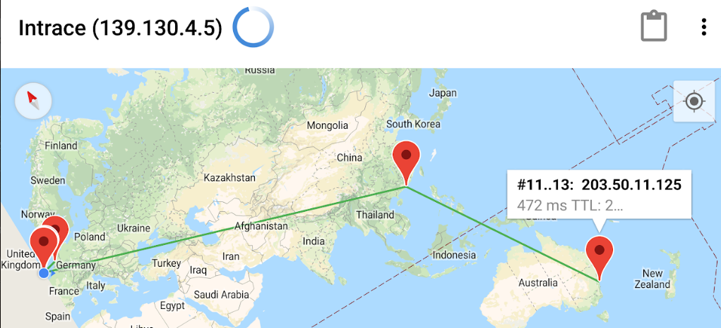
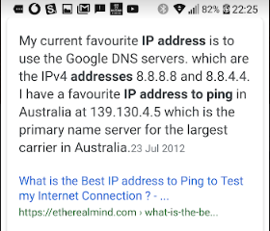
Experiences: Latency
https://www.youtube.com/watch?v=Nma5OfNRExE

Slide 6

Latency
Latency: Who should have the better response time?
You / Your Customer?
https://www.youtube.com/watch?v=Nma5OfNRExE
Use a cloud that is based closer to those who need the best response times.
Use friendly Customers: Ask them to do a spot test of your latency: Click> Start Button > Run > “CMD” > “Tracert <<Your website>>”
Add Up all the milliseconds through all the hops it took to get there.
The ideal is less than 200ms “Blazing Fast” = a total of 10ms.

Slide 7
Key Take-Aways (Tech-Guys)
Don’t make it fast – get the timing and hand-offs right to reduce overflow and lost records
Get a Cloud (physical installation) close to your clients to minimise Network Latency
Have your friendly clients run Trace Route from time to time

Slide 8



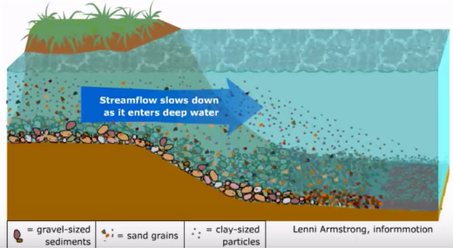

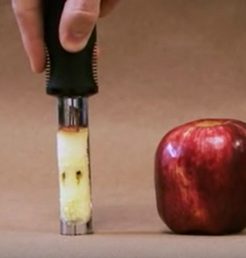
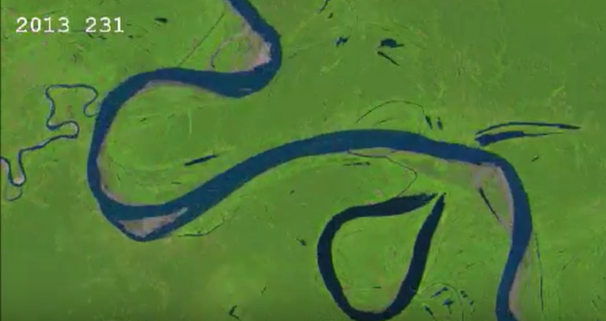
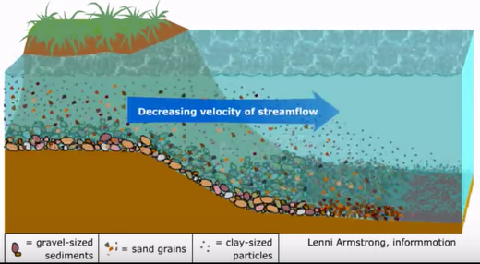
Data flows change over time creating stagnant pools and laying down different layers of meaning
https://www.youtube.com/watch?v=izgc3vFimP8, https://www.youtube.com/watch?v=jGhogd0G7_U, https://www.youtube.com/watch?v=tgp-v7mcjFM
Data Meaning changes over time. Understand what meant what, and when in the past so that you make no mistakes in the future

Slide 9
Key Take-Aways (Data-Guys)
Data Meaning changes over time, Document the history of the Business and the history of your Data flows.
Data can settle in your database after ingestion and contaminate your good data that flows, archive based on significant historical events
Ensure Data Queries draw data based on times when meanings are consistent to the data-request intention

Slide 10
Data in the minds of people
IP sits in the minds of people – Staff Churn destroys “Journey-knowledge”
Migrating from a Silo based enterprise to implementing MDM
1. Understand each business view of the data
2. Develop the Meta-data for each view
3. Get the Business Processes harmonized around an agreed single view
4. Migrate the human-working of the business to work in one way using the different Meta-Data to bring alignment
5. Embed the processes Manually and bring discipline to way of work
6. Implement MDM and use the Meta-data to align and migrate thoughts

Slide 11
Acquisitions and mergers (and Backwards Compatibility)
The Data restored has different formats to what the system has been changed to now.
  Different/Changed meanings of terms and definitions
  Different/Changed standards and protocols
  Decisions made based on previously existing policies, legislation, procedures
  Procedures that catered for data quality anomalies
  Field length, Special character use, permitted file sizes, readable file types.
Insist on a full historical explanation of the IT Estate, and what was bought and used and integrated into what at what time.
Understand the history of the changing data flows … because all that data is “living” in time-layers in your Data-Stores

Slide 12
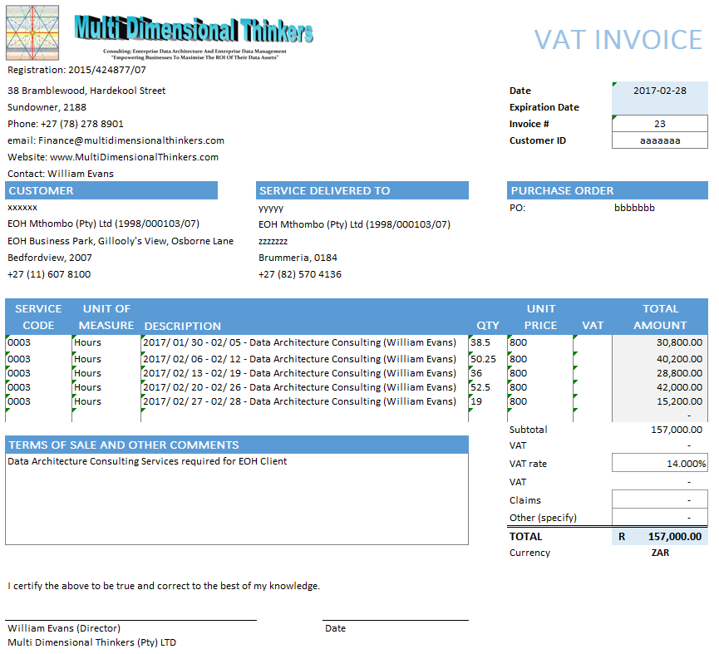
Visual of Data (An Invoice)
Meta-data
Reference Data
Master Data
Transactional Data

Slide 13
Analogy: When weaving a carpet, there are 3 different threads. Each thread is a data attribute. Each millimetre of thread is instantiated data of the attribute of that thread.
Here is a simple explanation of Data Functioning in an Enterprise
Discuss The analogy and the types of Data

Slide 14
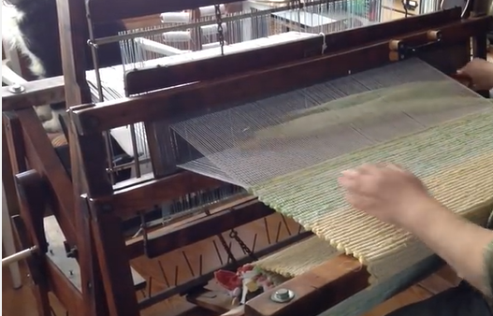
A small company weaving a transaction
https://www.youtube.com/watch?v=aT6gx4db7z8

Slide 15
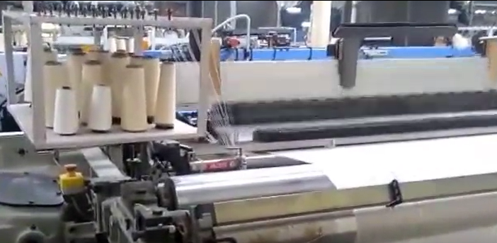
Siloed Management of Data in systems
https://www.youtube.com/watch?v=ZYU5T9t7-oo

Slide 16
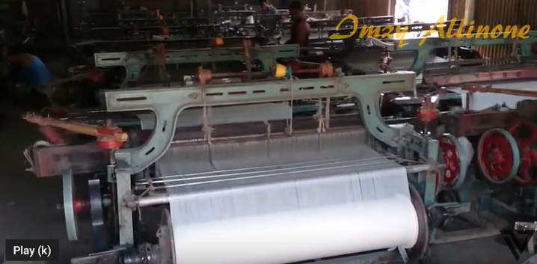
Business Silos with their own Data Sources
https://www.youtube.com/watch?v=Sztvjrkixzs

Slide 17
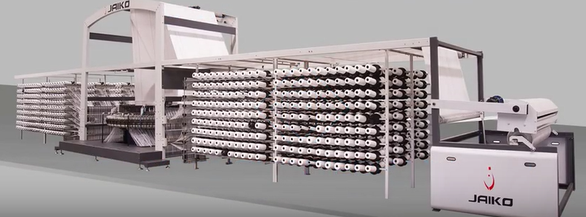
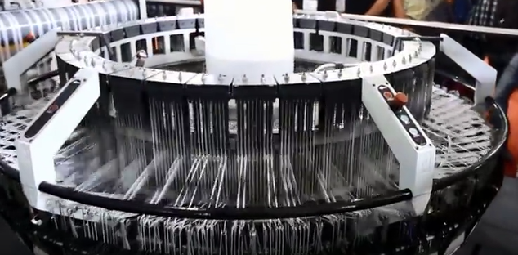
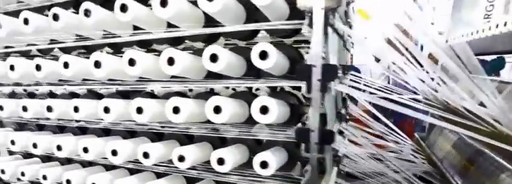
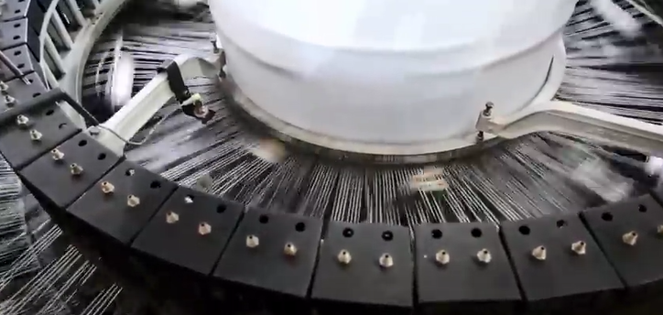
An Effective Data Governed Enterprise
https://www.youtube.com/watch?v=zhzf6cIEGM8

Slide 18
Key Take-Aways (Exec-Guys)
You have to change your Business Structure to leverage effective Data Management
You have to educate your staff to be able to work with one structure of a data object (ideally through one process) when implementing a single, simplified Technology Solution
CFO : CEO : CDO Discussion:
  CEO - Q: Which is more important, my money or my data?
  CFO - A: Your Money! – It is like water, without it the Business will die.
  CDO - A: Your Data! – It tells you if you have money and where it is. (amongst other things)
Data is like air:
  Today, Business dies a lot faster if you don’t have data than if you don’t have money.

Slide 19
Traditional Thinking vs Time Centered Thinking
Traditional Thinking:
- We add a date attribute to something we are doing … sometimes
Time Centered Thinking:
- We determine Assets of the Enterprise based on Time Cycles
- We use the Information Value Chain (IVC) to align the Enterprise to time
- We add Attributes to the time line, instead of time to the attributes
- We document the history of our assets against the same time line
- We map the Data flows and show historical data flows
- We map all these against the two triangles of:
  Enterprise Architecture (traditional apex-up-triangle mapped against IVC) and
  Service Oriented Architecture (apex-down mapped against IVC)
Notes:
To understand the MDDMF 4.0 Engine you have to throw away the traditional thinking of finding "diamonds" among your data and look at data rather as trying to find a specific type of flower (a flower would equate to the static data in your business - flowers, are time-bound and only easily recognisable as the flower you want for a short amount of time. Flowers are not going to be moving around your garden by themselves. There are other types of data you may be looking for in your garden, for examples, earthworms, which are good for the ensuring the quality of your soil, as well as those beetles that you know are there because of the evidence they leave of half chewed leaves, but you just can't seem to track them down as they are always on the move. There are still other types of data that you need to make provision for. These are the airborne ones that ensure your data can remain healthy, and can grow in the right way to strengthen other data, enhancing it. Creatures like bees and butterflies fit into this category. Finally there are the environmental elements peculiar to your particular garden. These can be a gentle breeze one day, a hurricane the next or soft soaking, helpful rain one day and destructive frost the next.
Understanding that your data undergoes seasonal effects is critical. Reading the signs of the likelihood of what weather you will be experiencing tomorrow, and equally important, what weather you had last week that is currently prompting you to rethink the architecture of your garden. Where and how you want to move your data for the best possible management of particular data is an ongoing operational activity.
At this point you may be thinking - "Oh so it is an ecosystem" - Yes and No.
The word "ecosystem" somehow creates the impression that you are outside of it, a witness to it. Not so ... You are a fundamental part of it. Your garden affects you and you affect it. You cannot escape it. Your actions provide a garden overgrown with brambles, thorns and weeds, bringing sorrow and frustration, or a garden that bears fruit, brings joy, can be played in. Data needs to be managed so that the Business experiences the latter and there are a plethora of ways to do this. But you are guaranteed to reap what you sow.
You have heard the words “Garbage in-Garbage out” used when IT reminds Business that it is Business who is accountable for ensuring their data is correct. Unfortunately, “Garbage-in-Garbage-Out id proving to be a misguiding statement. Using the analogy of the garden, Garbage out far exceeds Garbage in because data that is bad and rots also corrupts the data around it causing loss of confidence, sickness, and if not checked, can cause the death of the enterprise. data is a living organism in your business. Data Hygiene and health is foundational to your business' well-being.

Slide 20
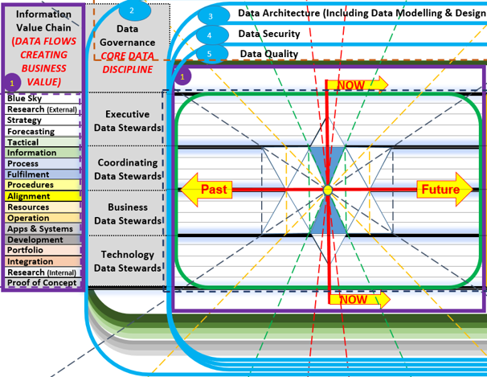
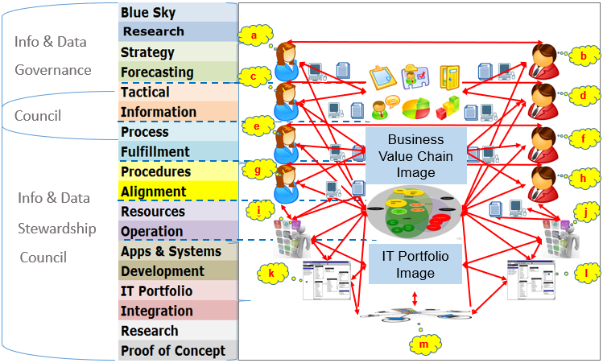
Manage Data against Time in the minds of people
www.multidimensionalthinkers.com

Slide 21
The best Data Manager, will be the person who is … a good Gardener. https://www.youtube.com/watch?v=1e0NDruyU0U
Time impact and cycles and windows of opportunity in a Garden must be paid attention to.
The Gold Analogy does not really work anymore, because gold does not decay,
However, all data is fluid and subject to time, much like a garden.
You can only pick and use the roses in a certain window of opportunity.

Slide 22
Blind because we have no Time Lens
Steps to take:
  Investigate and document the history of:
    All aspects of the Information Value Chain as it relates to each asset.
    All aspects of the assets as it relates to the Business and IT
    All the Data-Flows that used to exist between the Assets
  Map the histories together to provide working models of realities against time
  Set your time lens to the average frequencies of change
  Ensure full checkpoint of synchronized reality at that point in time
  Build a time-based Data-Fabric
Notes:
So what are the key concepts that must be borne in mind:
The first is that you have to realise that Time is no longer a limitation.
All Data is a representation as at a moment in time.
You can slide the lens backwards into history, or forwards into the future.
Naturally, If you haven't constructed your lens and data properly you will not be able to understand what you are looking at. It will be like looking into a Kaleidoscope…. Fragments of everything.
Our thinking has to change.
This is where the logic and insight of the simple gardener, the Food-shop manager, the farmer and the conservationist are extremely useful. They intrinsically understand how to balance these things. In fact, all you need to do is to explain to these people that (NB - Just one of many analogies) a computer software virus is just a program made up of data, and equates to a beetle in his vocabulary, and then he will ask you all the questions he would want to know to be able to identify the beetle in the garden, and you then need to define what the Metadata is that you need to construct and find and populate.

Slide 23
Misguided because Meta-data has changed
All that we understand a piece of data ,to be depends on Definitions:
A Data Definition Document is not enough anymore.
An accompanying time line with associated Definitions, which are:
  time stamped for start of use, extent of use and end of use (Toxic)
  Scope of definition of the new term (replacing previous term, specialization or generalization of terms)
Association of Meta-data based on true definition and terms
Changes to Definitions and Terms and updating of Meta-data to bring Meta-data into line with current definition.
Notes:
... Here is the punch-line - The meta-data you are given by the gardener is going to give you the lens to CREATE all the handles to be able to witness and manipulate the control over the Garden.
There are literally thousands of analogies you can use, but at the end of the conversations with your gardener, you will be faced with a potentially disastrous mistake.

Slide 24
Deceived because everything is working fine
You need a person who intrinsically understands the unseen world of data:
Key considerations are:
  Events are random or cyclical.
  Cultures determine data flow: logic to one is not logic to another
  Words are reused correctly, within different focus areas
  People are slow to understand and lazy to ensure understanding is correct
  Most people can understand data superficially from the outside of the ball
  Find people who can see what is happening inside the ball
  Find a Translator who can bridge the gap between:
    Business & Data
    IT & Data
Protect and keep your Data people – everyone is looking for them
Notes:
Pride will make you think that you no longer need the person with the understanding of the ecosystem (the gardener). You will then succumb to the effect of time on your data, and recovery will be an expensive, painful and fruitless period in time.
Like any real ecosystem, your data ecosystem is going to mutate and adapt. Storms will be different, new conditions will present themselves. You will need this person around long-term.
Unfortunately, Traditional Data Management practices of the past will help you build a garden that needs endless work to squeeze some basic insight out of.
Many of today's tools still use the logic of mining and not the concept of gardening. consequently, over time, they become a part of the problem.

Slide 25
Assuming consistent meaning is applied
Computer systems are relatively stable and consistent, but not clever
Human beings are relatively unstable and inconsistent, but very clever
Data Management includes data in people’s heads and technology.
People take time to upgrade and adjust their thinking.
People take time to change.
No Communication Quality checks are done on people
No enforcement on people of application of a single language
No calling out of assumptions and ambiguous and unqualified speech
No understanding of how these interact and cause the Data to respond
Notes:
Besides the ecosystem, there are other things that are subject to time -more specifically - you.
No one has a good handle on themselves, and fewer watch themselves to see what and who they are.
But we all do know that we are different personas (having responses, that appear at times disproportionately different from our "controlled self").
It is not just ourselves that have these different personas. The actors and influencers within the garden, are also subject to multiple personalities given different stimuli.
Understanding what stimulates your data, and how your data responds under different conditions is really important, for so many assumptions cause failed decisions, and consequences that have ripples of unintended consequences that run throughout the ecosystem.

Slide 26
Incorrect Identification due to seasonal effect
At different times we interact with others with different definitions
We have events which happen once but their effect is cyclical
We receive data from other sources with different sanitization dates
We issue data to recipients where we must change terms for their use
We have to merge data from different sources which have different cycle times
The Volume of the data may increase/decrease data quality
Some data only appears at certain moments in a cycle
Some data may appear once off, never to appear again
All Data must be used and provided ensuring Truth decay is provided.
Notes:
Another important understanding is that the seasons will also change what you see and what you don't see.
One closed flower may look just like another.
a wilting flower may be able to coaxed back to life, however, perhaps it is a flower that only exists in summer, and in winter it is gone.
The lens we look through is comprised of the sets of definitions we apply to the ecosystem within its season. This means that as we slide our "viewer" of the ecosystem, backwards to view how it existed in the past, or forwards to how it may exist in the future, we need to understand what everything meant/will mean at that time and understand it first as it was/may be, and then attempt (for sometimes it is not possible) to bring it into the context of now.

Slide 27
Unintended Consequences due to no insight
Removing data, causes data to move from high pressure areas to low
Changing data causes data to take add or lose properties
Data flow levels are seasonal, overuse can cause a loss of data in peak
People can behave irrationally reduced care = communication errors
Cause and effect should b documented and modelled and used
Whatever you do to the data will change something somewhere
Data is what we use to change our world. Data causes disruption
Stagnant data (not flowing) becomes toxic over time & deadly if used
Notes:
In terms of these forces (and there are others), each part of the ecosystem has a set of rules and intentions that they each obey.
These are affected by the various stimuli and so the intentions of the data and the actors can adjust the nature, form, meaning and usefulness of your data from minute-to-minute, or from day-to-day, or over weeks, or months.
If you took Salt and removed the Sodium, you would be left with something with different properties, e.g. volatility, poisonous, etc. Changed data must come with is warnings too.

Slide 28
Fatigue in Data Management Discipline
The KPIs and KPAs can create a poor data hygiene behavior
Seasonal, sickness and week-start/week-end proximity affect data
System age, overuse, & spaghetti programming cause data complexity
Managers with no insight into personnel triggers can cause fatigue
Poor understanding of how data works, and ebbs & flows around us
Insufficient agenda time discussing data related discipline
Expectation of additional role instead of effectiveness of current role
Data is always going out of date. Constant cleaning is mandatory
Notes:
The challenges that harmonising the Information Value Chain must overcome:
Imagine with all of this going on that there is a lack of discipline in one area of the garden, or among one or more actor's within the garden. You will not achieve the harmony necessary to ensure a flourishing, fruitful and joyful garden.
Common sense says if you automate a bad process that destroys a tenth of all you process, that automation will still destroy 10%, but because the automation is faster, you will have a lot more volume of destroyed value afterwards.
Common sense also says that that is simply not an intelligent use of your resources.

Slide 29
Assuming All Data is Accurate and Up-to-Date
When we provide data for a report we are complicit in the decision
All Data must be assured before providing it to Artificial Intelligence
Assure Data is correct with Data Quality metrics, measures and limits
Learn how to judge truth in your output before you give it to AI
All truth in your output must be measured against all forces of time
Understand how you respond to data, so that you can understand AI
Remember that to AI, you are just cold, hard data it can manipulate
Notes:
Enter Artificial Intelligence.
If you cannot manage your garden, nor understand all the intricacies and rules then the data you give your Artificial Intelligence will cause it to destroy your garden for you.
Get your garden in order first, understand it, become one with it so that you understand how your data behaves, in the seasons and across the seasons.
Most importantly, become the role model you want your Artificial Intelligence to emulate.
Journal the thoughts you have, how you think and what you watch for. Then teach your AI how to get right what you are getting right. Only allow your AI to run on the data when you can see that the AI understands and knows how to work with your garden without breaking it down, without throwing it out of balance, and very importantly, without making you of no value.
Never forget that you are still a part of the garden.
Your Artificial Intelligence is going to have to do something with you, so make sure you already have a job, preferably one that it cannot emulate, or replace you with.

Slide 30
Keep proof over time of Data Quality
You need to be able to manage your data over time and trend quality
You need to be able to motivate trust in your input quality
AI will blame you for poor Data Quality that it uses to make decisions
People are relatively slow. It is quite easy to catch an error
AI is very fast. Great damage can be done before you catch it
Get one AI to monitor the output of anther (segregation of duties)
Give yourself the job of Data Manager over the AI.
Use your gut instinct to stop a process. Instinct is faster than AI.
Figure out why you feel what you do then proceed
Notes:
Singularity by definition is where AI is in full control. If you control the data that describes and gives you control of the garden that the AI has to work in, well and good. You then have "Managed Singularity", but if the AI believes you cannot manage the data, it will take this job from you too, redefine you as an unwanted beetle in the garden and remove you from it.
Find people who think like gardeners to help you manage your data.

Slide 31
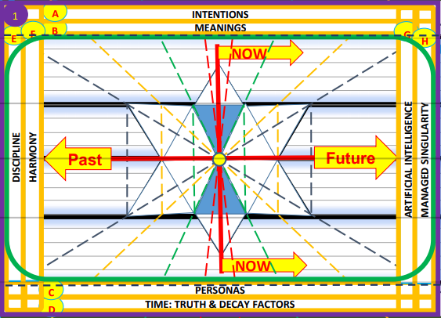
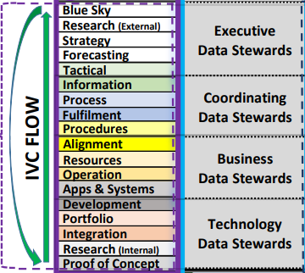
Time impacts the Core of Active Data Management
Insights from YHWH
Notes:
Version 4.0 of the Multi Dimensional Data Management Framework addresses the impact of Time, as well as the need for an integrated response to working with Data.
INTENTIONS:
MEANINGS:
PERSONAS:
TIME: TRUTH AND DECAY FACTORS:
DISCIPLINE:
HARMONY:
ARTIFICIAL INTELLIGENCE:
MANAGED SINGULARITY:

